Slide 1
Congregational Listening: ONA Covenant

Slide 2
Opening Prayer

Slide 3
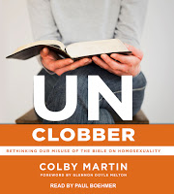
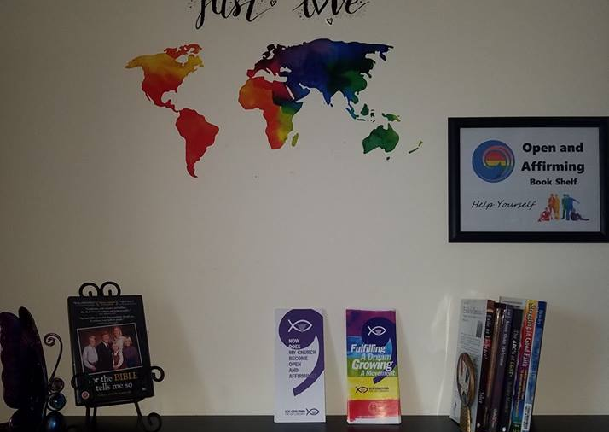
Ona Core Team

Slide 4
The ONA Journey
Back in 2017, after members of the Council attended two webinars/workshops hosted by the UCC Coalition: ONA 101 (Basics) and ONA 102 (ONA and The Bible), a decision was made that it was the right time to pursue the ONA Process for this church. Reverend Erika Breddin traveled to our church and presented an in-depth ONA Workshop. Council then formed a special committee called the Core Team, in spring of 2018, consisting of myself, Miriam Cartner, Kelly Fuhrmann, Cameron Hartley, Marla Romig, and Tom Shear.

Slide 5
OnA Journey Cont.
As charged by Council, the Core Team pursued, studied, strategized, brainstormed, and prayed over the ONA Process. We had a lot to learn, but we also needed to share what we learned along the way. We realized an important element of learning is not only studying but participating in open discussions. We thought Faith Formation was just the instrument for that. So we asked Bob Boggs for his help. Bob, our Adult Faith Formation “professor” spent several months last fall, taking us through the book called Unclobber, written by pastor Colby Martin.
The book clarified the clobber passages that have been misinterpreted by the church and held against the LGBTQ community for centuries. Attendance for classes was outstanding and the discussions were quite meaningful. Many thanks go to Bob!

Slide 6
ONA Journey Cont.
The Core Team attended LGBTQ events and activities at other churches and businesses. Some examples are the following: 1.) A live performance called Stolen Moments: Intergenerational LGBTQ Voices from NE Ohio at the Maltz Museum in Cleveland, 2.) Call Me Malcolm: a movie about a transgender pastor and then an open discussion at sister church UCC-Fairport Harbor, 3.) attended Four-Part Bible Study: Queer Eye for the Bible delivered by four area pastors in NE Ohio. 4.) We attended a movie in Erie called Boy Erased about conversion therapy used on teenagers to erase the gay-out. It’s horrifying that conversion therapy for minors is still legal in 32 states.

Slide 7
Ona journey cont.
We conducted a congregational survey; we had one-to-one conversations; we added special quotes to the bulletin; we shared personal stories with the congregation on the third Sundays of many months; we invited guest speakers, and guest pastors. Rev Beth Long-Higgins presented The United Church Homes and the important work they are doing providing a safe place for LGBT Seniors.
And now we’re here today to share the proposed covenant. Please listen while a few members of the Core Team briefly say why they decided to be a part of this process. Then our Council members will share some answers to frequently asked questions. We will explain the essence of the covenant and then share it with you.

Slide 8
Sharing from Core Members
Kelly
Tom
Miriam
Marla
Cameron

Slide 9
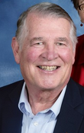
No Matter Who You Are, Or Where on Life’s Journey, You Are Welcome Here!

Slide 10
No matter who you are!
“Open and Affirming” (ONA) is a movement of more than 1,500 churches and other ministries in the United Church of Christ that welcome lesbian, gay, bisexual, transgender and queer (LGBTQ) members. More than 350,000 members of the UCC belong to ONA churches—and our movement is growing rapidly.
After a time of study, dialogue and prayer, churches adopt an Open and Affirming “covenant” committing their members to welcome LGBTQ seekers, support their relationships, and advocate for their basic rights. All sacraments and rites of an ONA congregation are available to LGBTQ people, including baptism, confirmation, communion, and marriage. ONA churches take seriously the Bible’s admonition to “accept one another, just as Christ accepted you, in order to bring praise to God.” (Romans 15:7, NIV)

Slide 11
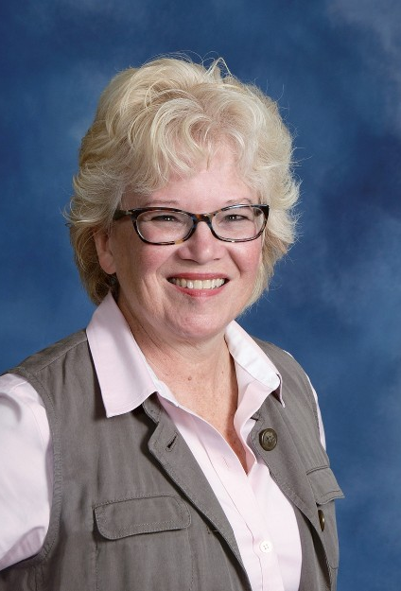
Why isn’t, “All are welcome” enough?

Slide 12
Lesbian, gay, bisexual and transgender (LGBT) people of faith often experience emotional and spiritual injury in churches that condemn their capacity to love and seek love. Because we’ve learned that “All Are Welcome” usually doesn’t apply to us, we can’t assume that any church will be safe for us and our families.
A public welcome by an Open and Affirming (ONA) church sends a clear message to LGBT seekers that they have a home in the United Church of Christ.
A congregation’s affirmation and support through an ONA covenant can be a life-changing and life-saving experience—especially for LGBT youth.
A public welcome to LGBT persons helps churches grow. When new ONA churches attract new members, many of them are young straight couples starting new families: they identify with the values ONA represents, and want their children to learn the faith in a welcoming church.

Slide 13
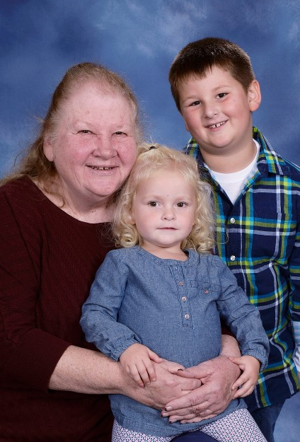
What does it mean to be an open and affirming church?

Slide 14
A congregation becomes Open and Affirming when it affirms a public covenant that “lesbian, gay, bisexual and transgender people (LGBT)” (or people of all “sexual orientations, gender identities and expressions”) are welcome in the full life and ministry of the congregation (e.g. membership, leadership, employment). Through its covenant, the congregation promises to live out that welcome in meaningful ways in response to Christ’s teaching of radical hospitality.

Slide 15
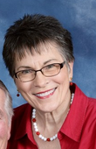
How Will our ONA Covenant Make a difference?

Slide 16
Your ONA covenant will make a difference to lesbian, gay, bisexual, and transgender adults who have personally experienced silence or condemnation in other churches. It will make a difference to LGBT youth who are at higher risk for suicide when they experience bullying or mistreatment because of their sexual orientation or gender expression. It will make a difference to parents of LGBT children whose families need the same affirmation and support congregations offer to other families. It will make a difference to LGBT seniors who are often closeted, isolated or abused in retirement communities and nursing homes. It will make a difference to all Christians who experience a deeper understanding of the Gospel and a stronger commitment to Gospel values when the congregation reaches out in love.

Slide 17
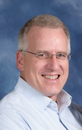
If we are already LGBT Welcoming… Why do we need to be Open and Affirming?

Slide 18
Each Open and Affirming congregation is part of a growing movement of LGBT-welcoming churches in the United Church of Christ. When your covenant is certified, your congregation will be officially listed on the Coalition and UCC websites as an ONA church, and on other sites often used by LGBT Christians searching for a church family. Moreover, you will be connected with other ONA congregations and with the Coalition’s resources on evangelism, worship and advocacy. And by participating in the ONA movement, your congregation will be able to share its gifts with other congregations that are exploring ONA for the first time, or seeking new ways to live into their ONA covenant.

Slide 19
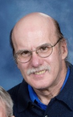
Can we simply say, “All Are Welcome”?

Slide 20
Can we simply say, “all people are welcome”?
No, not if you wish to be listed by the Coalition as an Open and Affirming congregation. LGBT Christians have learned from painful experience that a vague welcome often doesn’t include them and their families. The words are important. Just as a marriage covenant normally centers on an exchange of vows, an ONA covenant shows that the congregation is serious about its commitment to LGBT inclusion.

Slide 21
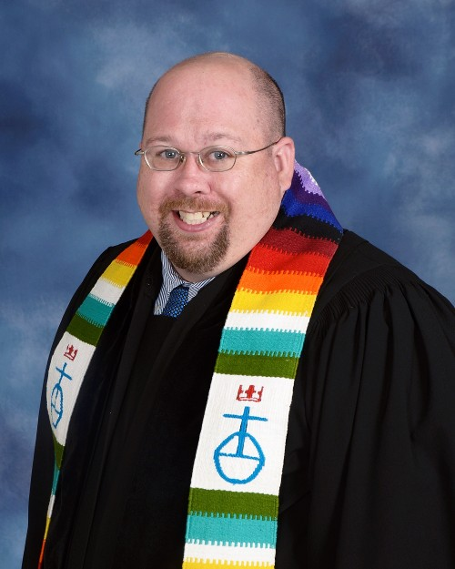
What is a covenant versus a contract?

Slide 22
What is the Difference Between a Contract and a Covenant?
A Contract says: I don’t trust you. You don’t trust me. I’m going to watch you and you watch me to make sure I keep to our legal agreement.
A Covenant says: I love you. You love me. We are going to write down our understanding of our relationship and pray that God brings us closer together in this spiritual and theological agreement.
Ex. Genesis 17:7 English Standard Version (ESV)
7 And I will establish my covenant between me and you and your offspring after you throughout their generations for an everlasting covenant, to be God to you and to your offspring after you.

Slide 23
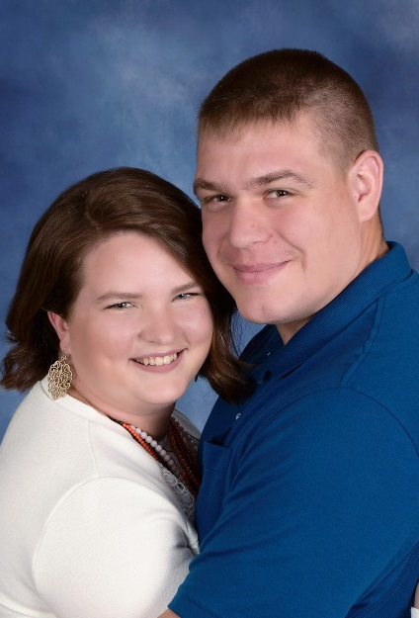
What Exactly is an ONA Covenant

Slide 24
A written covenant is essential to put your church on record that it is truly an Open and Affirming Congregation and is a requirement for certification. A covenant will show LGBTQ seekers that your church is a safe spiritual home for them and their families. Use language that is authentic, reflects your congregation’s values, and includes a specific welcome to the transgender community.

Slide 25
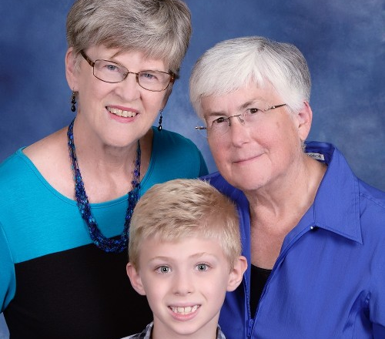
Our Church’s ONA Covenant is the beginning not the end of our Journey of Faith!

Slide 27
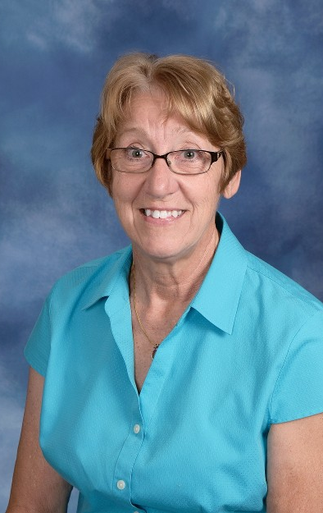
What is the essence of an ona Covenant

Slide 28
It affirms a specific WELCOME to persons of all “sexual orientations, gender identities and gender expressions” (or persons who are “lesbian, gay, bisexual or transgender”) into the full life, ministry and sacraments of the church (e.g. membership, leadership, employment, marriage).

Slide 29
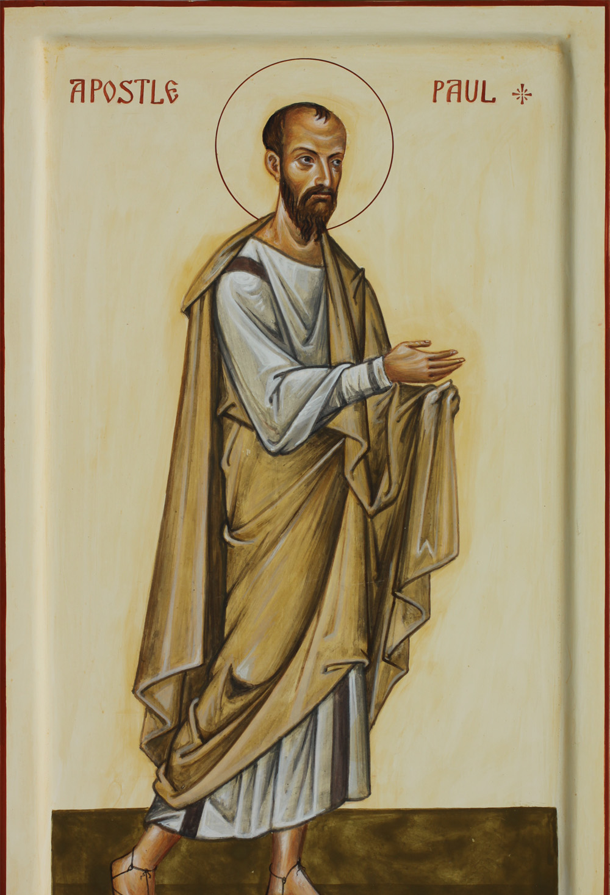
“By Adopting An Ona Covenant,
A Congregation is taking Seriously The Apostle Paul’s admonition to,
Accept one Another, just as Christ accepted you. In order to bring praise to god.
Romans 15:7

Slide 30
Acceptance
You heard me say that the Core Team was involved in several social and cultural educational experiences in the past year. We brought back what we learned and shared it with you. We shared at the lectern on Sunday mornings, we shared in Adult Faith Formation classes, we posted things in the weekly bulletin, the Tower Bell or The Belfry. But I feel one of the most important activities we did this year involved all of you.

Slide 31
Acceptance Cont.
The Core Team members deliberately engaged in graceful listening, gentle conversations with the friends and members of this congregation. We used conversations as a tool to get to know you, to learn what is in your hearts and on your minds. When we sat down to draft the proposed covenant, we crafted the words, the phrases, the meaning from what we heard you say. The Proposed Covenant is about showing the love that Christ taught us, showing our commitment to love all of God’s children. This Covenant speaks from the heart of First Congregational United Church of Christ.

Slide 33
Proposed 2019 Covenant
We the members and friends of First Congregational United Church of Christ, Jefferson,
Ohio stand united in Christ’s love to proclaim this church as “Welcoming To All.”
We affirm, “There is neither Jew nor Greek, there is neither slave nor free, there is no male
and female, for you are all one in Christ Jesus.”

Slide 34
Cont.
We hold sacred the diversity of
humankind, celebrating the uniqueness of each person, understanding that all persons
are “fearfully and wonderfully made” in the image of God.
Therefore, we declare our church to be Open and Affirming; welcoming lesbian, gay,
bisexual, transgender, queer, intersex, asexual (LGBTQIA+), the full spectrum of gender
identities, their families and allies.

Slide 35
Cont.
May it be resolved, that we pledge ourselves to create a safe space in which
everyone is invited to participate in the worship, rites and sacraments of this church.
We encourage all persons to participate in the full life of the church and to share in
its ministry and mission, leadership, fellowship, faith formation, local and global
missions, responsibilities and graces.

Slide 36
A time for sharing

Slide 37
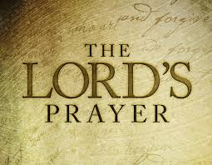
Closing:

