Slide 1
A Context for Structuring for Vision & Mission

Slide 2
What is the business of the Church?
What does a church do?
What is its purpose?

Slide 3
What is the business of the Church?
Nurture the spirit – Worship Faith Formation/development
Foster community – Care, visit, hospitality…
Heal the world – mission, outreach, advocacy

Slide 4
Does the congregation have a mission and vision statement? Or, Purpose and priorities?

Slide 5
Vision is aspirational. Furture What/who do we want to become? Mission is practical. Present. What is our purpose & direction today to get there?

Slide 6
Wider Church Context
Early Church, 300s, Church separate from culture, with unique identity
Countercultural minority
Outside world hostile to church
300+ Church becomes state religion, an establishment, an institution
Unclear lines between religion and state
Church and empire – equal
Uniformity of faith and same belief. Unity.

Slide 7
3 ages of faith
Age of faith – The people of the way
Age of Belief – Uniformity of belief, religion & state, sacred & secular unclear, Creeds & Faith statements
Age of Spirit – experiencing God, religious pluralism, universal spirit

Slide 8
Changes in last 100 years
Modernism – provable truth
Postmodernism – subjective truth
After postmodernism – elusiveness of meaning. Interactive.
Generational Differences
Change in faith Questions
Pace of change is 18 months

Slide 9
New paradigm - NOW
FROM TO
Conversion Service
Exclusive Inclusive
Civic faith Change & healing
Good Christian Experiencing God
Board culture Ministry culture
Official Gifted leadership
Head/reason Heart/mystical faith
Separate boards Unity of Purpose
Far away mission Local mission

Slide 10
Moving from To
LOYALTY generation to RELATIONAL generation
Paper to tech
Control/ power to authenticity
Sameness to diversity
Local to global
Learning intellectually to experiencing
Monologue to interactive

Slide 11
UNLCEAR/TENSIONS
Does the church exist for itself or other?
As an institution the church preserves tradition. As a faith walk church is about renewal, transformation & rebirth.
Tradition or Innovation? Both?
Management or Leadership?
Process or Ministry?
Who is the leader of the congregation?

Slide 12
MANAGEMENT/MAINTENANCE | VISIONARY LEADERSHIP
Administers and oversees | Innovates, inspires, creates
Focuses on systems & structure | Focuses on people & their gifts
Is imitative and status quo | Is original, creative & challenges
Has a short-range view | Has long-term vision
Asks details of how & when | Asks what & why, intentional & purposeful
Criterion is the bottom line | Considers all possibilities
Does things right | Does the right thing
Plans and budgets | Creates vision and strategy
Maintains stability and comfort | Creates new ways and produces outcome
Creates efficiency & organization | Creates integrity & personal growth

Slide 13
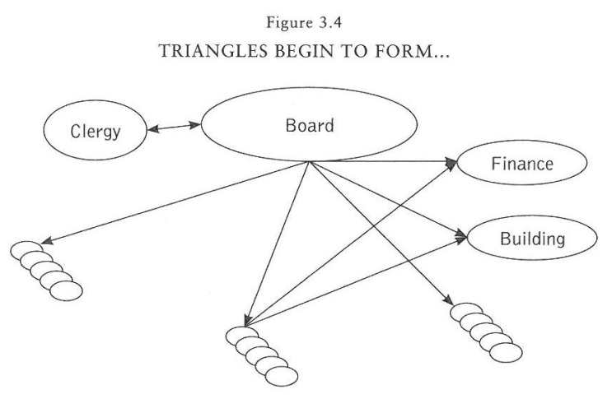
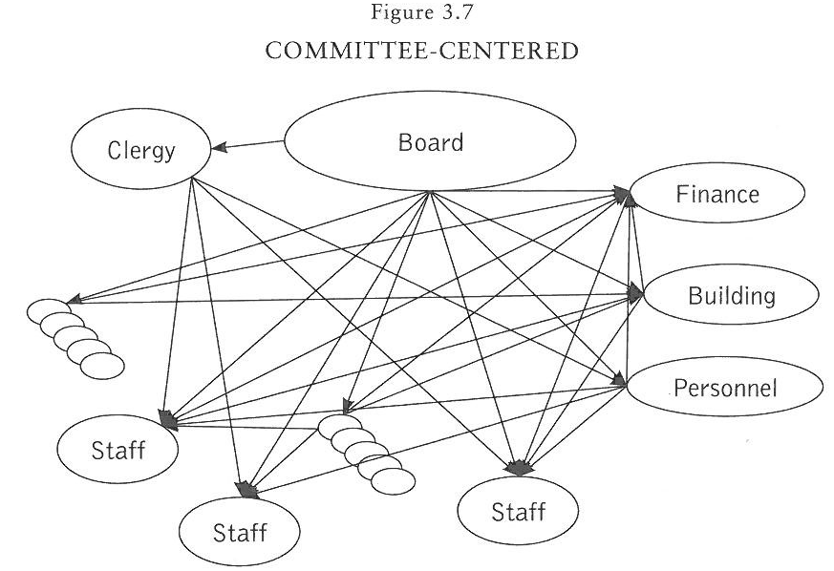
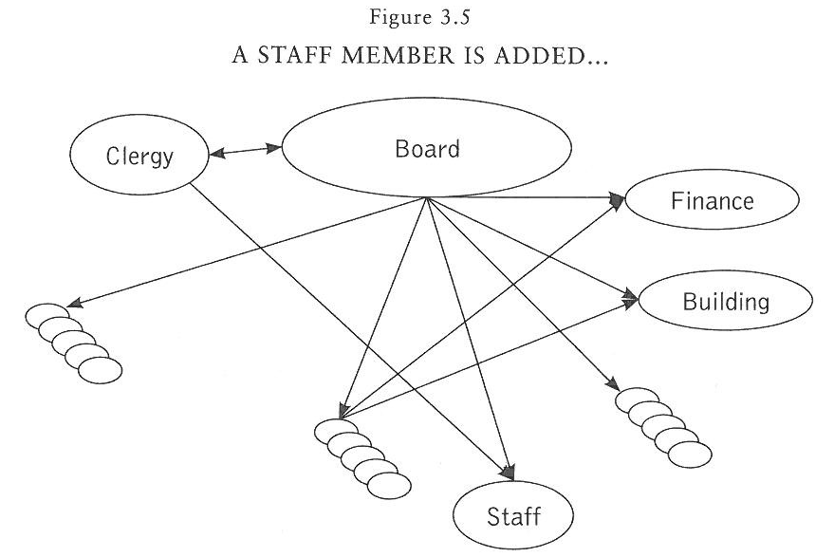

Slide 14
Committees and Teams

Slide 15
Innovative – Governance, Ministry

Slide 16
Traditional Governance
Board based
Maintains what is
“Governing body” is representative & receives reports
Boards are autonomous
All agendas consist of issues of finance, administration, ministry, events planning…
All are elected positions

Slide 17
Three tasks/processes
Governance
Administration
Ministry

Slide 18
Governance
Governance is the process which directs, oversees, &
provides leadership on the overall ministry of the church
always looks at the big picture/vision
sets goals and policies
evaluates ministries and programs
manages, runs and sets parameters, “controls”
clarifies and gives guidance

Slide 19
Administration
Administration is the process which manages, maintains and runs the day to day practical business of the church
does the practical work of maintaining/managing
ensures that policies and parameters are followed
prepares annual budgets and oversees them
manages contracts and personnel policies
evaluates staff and gives guidance on day to day administrative issues

Slide 20
Ministry
Ministry is the process which tends to &
implements the calling, vision and mission of
the church through hands on action
serves, attends to and cares for community & beyond
continually strives to achieve and fulfill the calling/vision of the church through action
does hands on work to make a difference
offers care, healing, inspiration, challenge, comfort, dignity, justice, hope…

Slide 21
The three tasks
Conventional congregations governance and ministry are not generally distinguished. All teams give energy & time to running, managing, and doing ministry, usually not with great results.
Innovative congregations there is a unified structure for making governance, administrative and ministry decisions with clear boundaries and active mutual communication and accountability.

Slide 22
Conventional Innovative
3 tasks unclear 3 tasks clear
Board based Community based
Representative body Governing body
Maintenance Leadership
Management Visionary leading
Autonomous boards Connected teams
Elected positions Gifts of the people
No common vision Common vision
Program Ministry

Slide 23
Structuring for Vision & Mission
Is spiritual, based on CALLING & VISION of the church
Whatever you give energy to grows
Is intentional, encourages use of gifts, focus of time, attention and energy
Gives holistic direction to the church’s ministry
Creates community, inspires and motivates
Nurtures ministries & action instead of programs
Continues to discern vision and mission
Works from the energy field of the congregation
Hears “what God is calling us to do and be?”

Slide 24
Structuring for Vision & Mission
Committee or team?
Representative of Gift based?
Elected or non elected?
Programs or Relationships?
Do what we’ve always done or nurture the gifts of the people to change the world?
Constitution and bylaws – reflect vision and values? OR are they a hindrance to ministry?

Slide 25
COMMITTEE | TEAM
Committed to common goal | Committed to achieving a common goal
Appointed or “elected” to perform a function on behalf of a larger group | Chosen because of gifts and skills in the area of team’s purpose
Members’ primary role is to represent the people who “elected” them | Members primary role is to act, to implement the goal
Achieves common goal, always mindful to do in the best interest of their group | Implement and act. Always motivated to make something happen
Bound by bylaws with very specific function within the organization | Bound by mutual respect to work together
Decisions by voting usually through majority vote, winners and losers | Decisions by consensus or agreement, building community without lose
Takes minutes | Takes notes
Is based on deliberation | Is based on action
Creates programs | Creates relationships and ministries
Not all members agree on goal/purpose always (majority) | All members agree on goals/purpose always

Slide 26
OFFICIAL LEADERSHIP | GIFTED LEADERSHIP
Elected or appointed to fill office | Called or chosen to be part of team
Elected to represent the larger group | Called to do/act gift & passion
Elected to fill a vacancy | Called to use/share their gifts
Make decisions, act on behalf of larger group | Called to act and inspire others to act
Burn out. Run out of energy | No burn out. Inspiration and energy
Bound and limited in scope of action according to office they hold | Boundaries of mission and values are much larger
Fill the office because no one else wants | Enthusiasm to be part of a team
Representing a group might feel as if they are not making a difference | Putting their gifts into action, feeling they matter and make a difference

Slide 27
Structuring for Purpose and Vision
Is spiritual, based on the CALLING of the church reflected in its vision, mission and goals.
Separates the work by tasks: Governance, Administration, Ministry
Whatever you give energy to grows
Is intentional, encourages use of gifts, focus of time, attention and energy
Gives holistic direction to the church’s ministry
Creates community, inspires and motivates
Nurtures ministries & action instead of programs
Continues to discern vision and mission
Works from the energy field of the congregation
Hears “what is God calling us to do and be now?”

Slide 28
Some important concepts
Governance positions – elected
Administration positions – elected & non-elected: volunteer, gift discernment & development…
Ministry – non elected
GIFTS – Ministry and service based on gifts rather than filling a “position.”
Match the gifts of the people with the vision/needs & mission of church
Each non-paid position should have a clear job description
Create written policies, making work more efficient
Be clear in Communication

Slide 29
Governance and Ministry
Governance Ministry
Executive Council
Ministry Council
Administration
Committees
Action
Ministry teams

Slide 30
EXECUTIVE COUNCIL
Elected
Governance, Leadership, Decision-making
ADMINISTRATION Elected or Non-elected
MINISTRY ACTION TEAMS
Non-elected
RESOURCES: Finance, Stewardship, Generosity
Personnel/human resources
Building/Property
Mission Outreach – monetary
WORSHIP: Ushers & Greeters
Communion Servers
Audio visual team
FAITH FORMATION
FELLOWSHIP/CARE
Hospitality/Reception, visitation,
Nominating//Leadership dev
HANDS ON MISSION
Council: Moderator, vice moderator, clerk, treasurer. 3 at large members gifted for leadership. All Elected. Administration Resources, elected or not. Ministry Action Teams not elected, gifts and passions

Slide 31
GOVERNANCE Board
7 members elected by Congregation
4 Executive – Moderator, vice, treasurer, clerk
Strategic thinking, Ensuring church’s vision & direction, Creating policies,
Establishes teams that provide ADMINISTRATIVE support.
Each committee develops “ways of work.”
MINISTRY
Pastor, paid staff and lay leaders necessary to realize the vision & mission of church.
Pastor facilitates establishment of Ministry teams, with non-elected, gifted members to realize vision & mission of the church.
Each team develops “ways of work.”

Slide 32
Council/Cabinet
Elected positions, 3-5 each
Growth & Membership
Fellowship
Faith Format.
Worship
Staff relations
Stewardship
Generosity
Missions
Property
Non Elected ministry positions
Drama Ushers Av Children & Youth Resource Visitation Hospitality
Scholarship Audit Memorials Soup kitchen FACC Garden
Communion preparers

Slide 33
Worship &
Faith Form.
Leadership
Administ. &Resources
Leadership
NON ELECTED
Ministry Teams:
Worship team
Music, drama, flowers…
Ushers team
AV team
Education Team
Children Sunday school
Adult education
Council/Cabinet
Elected
NON OR ELECTED
Ministry Teams Finance team
Stewardship/giving development team
Memorial
Building team
Staff/personnel
Care & Community
Leadership
Mission
& Outreach
Leadership
NON ELECTED
Ministry Teams
Care/visitation, Hospitality
Fellowship/congregational life
Nominating/Leadership development
Evangelism/Growth
NON ELECTED
Ministry Teams
Outreach team, Green Team,
Wider/Ecumenical/Interfaith
Peace & Justice
Council 7-9 persons: moderator, vice moderator, clerk, treasurer. 4 chairs of Ministries, 1 at large member.
WE, CC, MO, AS Ministries 5 members each. All Elected. Action Teams not elected, gifts and passions

Slide 34
Worship &
Spiritual Life Lead.
Mission
& Outreach
Leadership
Council/Cabinet
NON ELECTED
Ministry Teams:
Worship team
Music, drama, flowers…
Ushers team
AV team
Administ. &Resources
Leadership
NON ELECTED
Ministry Teams
Outreach team, Green Team,
Wider/Ecumenical/Interfaith
Peace & Justice
ELECTED
Finance team, Stewardship/generosity team, Building team, Staff/personnel Team
Faith Formation
Leadership
NON ELECTED
Ministry Teams
Care/visitation, Hospitality
Fellowship/congregational life
Nominating/Leadership development
Evangelism/Growth
Care & Community
Leadership
Education Team
Children Sunday school
Adult education
Council 9 persons: moderator, vice moderator, clerk, treasurer. 5 chairs of Leaderships

Slide 35
Worship
&Education
Leadership
Administ. &Resources
Leadership
Council/Cabinet
MINISTRY TEAMS:
Worship Ministry
Music & Arts – drama, flowers…
Ushers, AV
Education Ministry
Children SS
Adult, Youth
MINISTRY TEAMS:
Finance team
Budget, Audit, Memorials, Endow..
Stewardship/giving development
Building team
Staff/personnel
Ministry/leadership coordination
Care & Community
Leadership
Mission
& Outreach
Leadership
MINISTRY TEAMS:
Care & Cong Life
Visitation, Hospitality, Fellowship
Evangelism/growth
Leadership Dev./Nominating
MINISTRY TEAMS:
Outreach team
Wider/Ecumenical/Interfaith
Local missions
Peace & Justice
Green Team, O&A
Council: Moderator, vice moderator, clerk, treasurer. 3 at large members gifted for leadership. All Elected. Leadership Coordination: Chairs of Leadership Teams. Ministry Teams not elected, gifts and passions

